Slide 1
Rolling Out the Bunzl Advantage Ordering System
01/05/2025
Rob Morrison – Head Of Operational Systems

Slide 2
Why Are We Rolling This Out?
Modernise our ordering process
Real-time visibility of order status
Reduced manual errors
Compliance with approved products and suppliers
Standardisation of approach to ordering
More sustainable business through catalogue management
Access to invoices, credit notes and PODS
Enhanced product information and SDS compliance
Mobile friendly to order anytime and anywhere

Slide 3
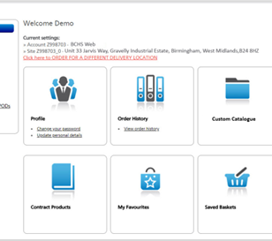
What Is Bunzl Advantage?
Market-leading online ordering portal
Pre-loaded approved product lists
Safety Data Sheets library stored withing Bunzl Advantage for quick access.
Repeat ordering & email confirmations
Real-time tracking & management reporting

Slide 4
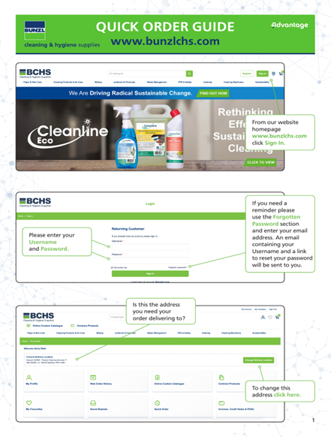
The New Ordering Process (Not TFL)
Create order in Bunzl Advantage Portal
Raise PO in IBMS
Approval required by IBMS approver
Input PO number into Bunzl
Submit order
Track progress in real-time

Slide 5
Quick Tips from the Portal
Use your Custom Catalogue or Contract Products
Add items directly to basket
Enter your PO before submitting
You'll receive confirmation & tracking email
nationalaccountsupporthub@bunzlchs.co.uk for issues

Slide 6
Key Benefits
Faster, more reliable ordering
Real-time tracking and updates
Easier spend and product compliance
Better visibility and audit readiness
Meets ABM’s Sustainability Targets

Slide 7
Support & Go-Live Info
Go-Live Date: 01/06/2025
Training will be provided by the Bunzl team WC 26/05/2025
Helpdesk support will be available if any queries
Contact: Robert.Morrison@abm.com / Jay.mahadevan@abm.com
More comms to follow.

